Slide 1
Progressive Growing GANs & StyleGAN 2
Víctor Uc Cetina

Slide 2
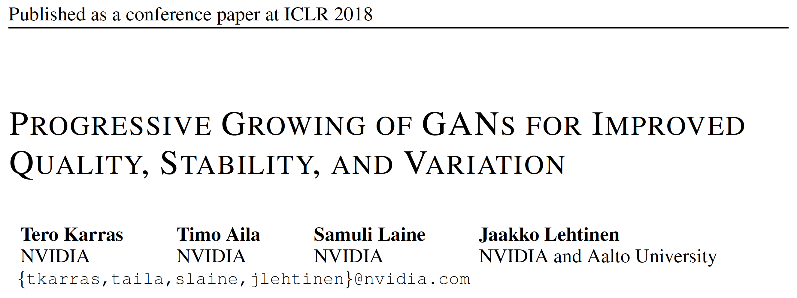
Progressive growing GANs (2018)

Slide 3
Progressive growing GANs (2018)
The key idea is to grow both the generator and discriminator progressively:
Starting from a low resolution, new layers are added to model increasingly fine details as training progresses.
Faster training and more stable:
Unprecedented high quality images, e.g., CELEBA images at 1024 x 1024.
A new way to increase the variation in generated images:
A record inception score of 8:80 in unsupervised CIFAR10.

Slide 4
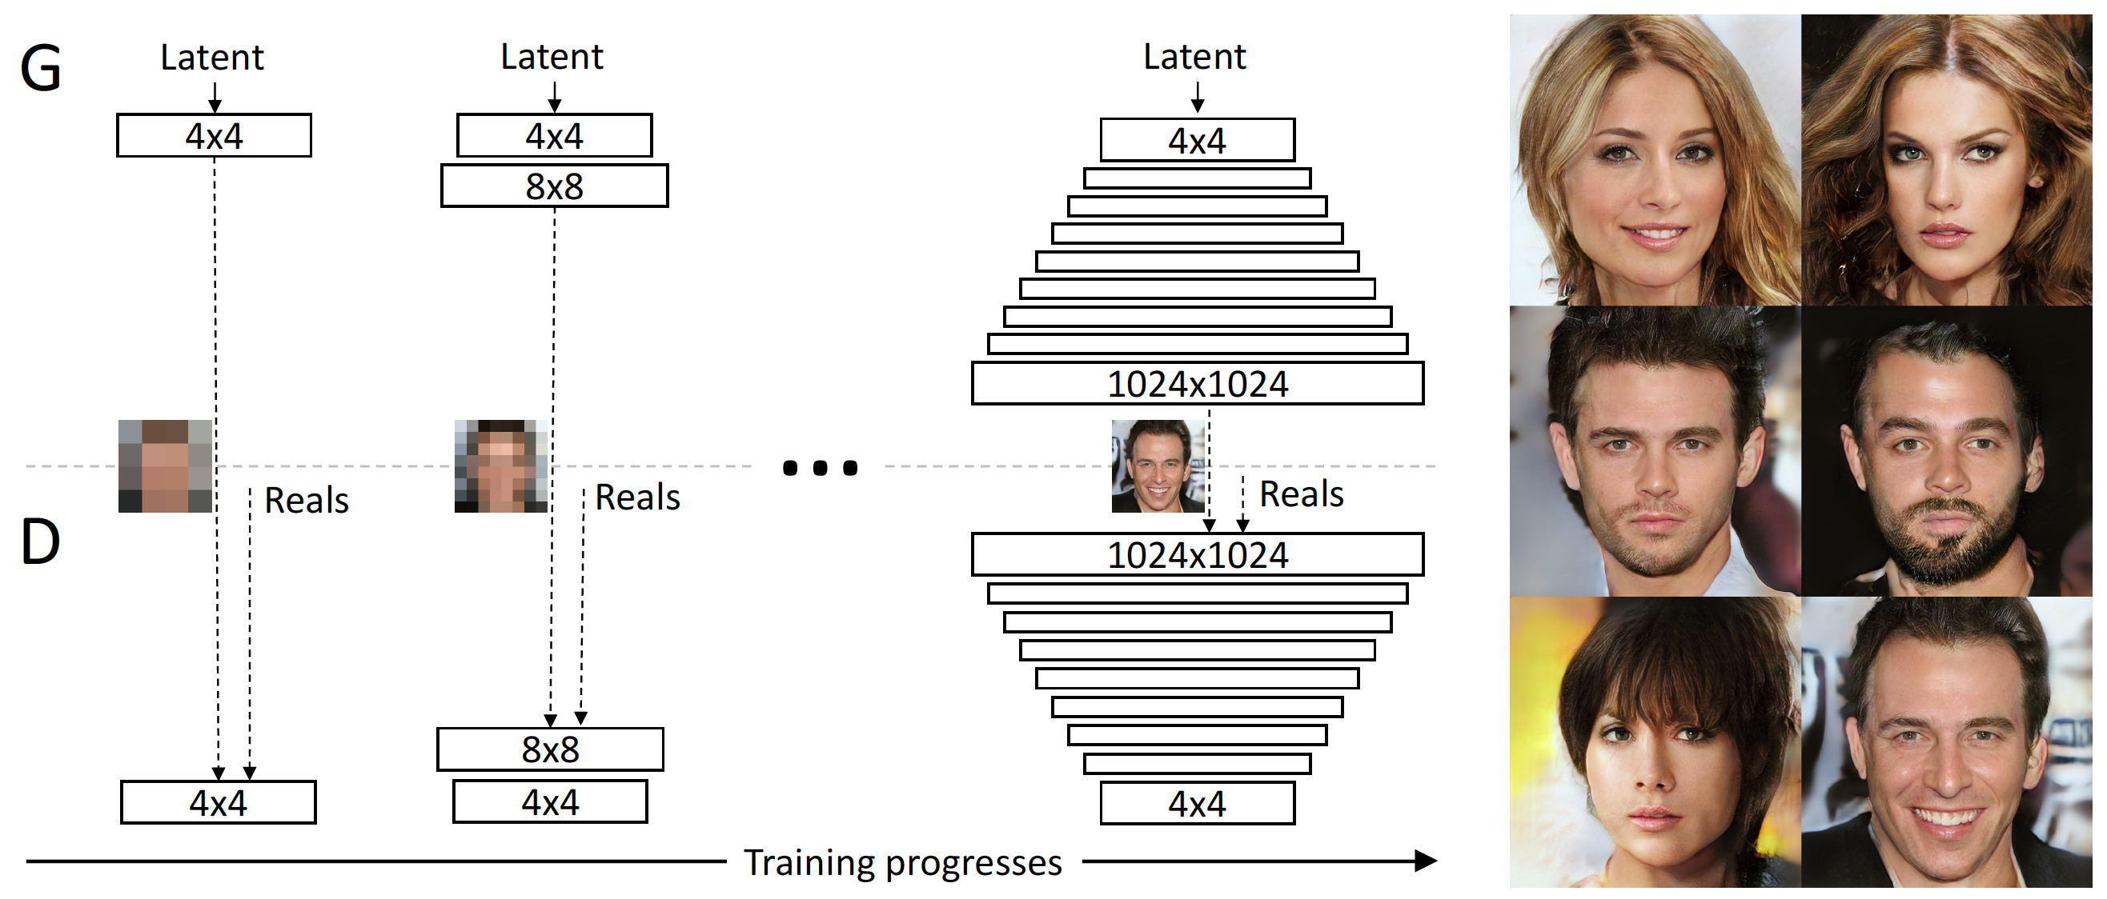
Progressive growing GANs

Slide 5
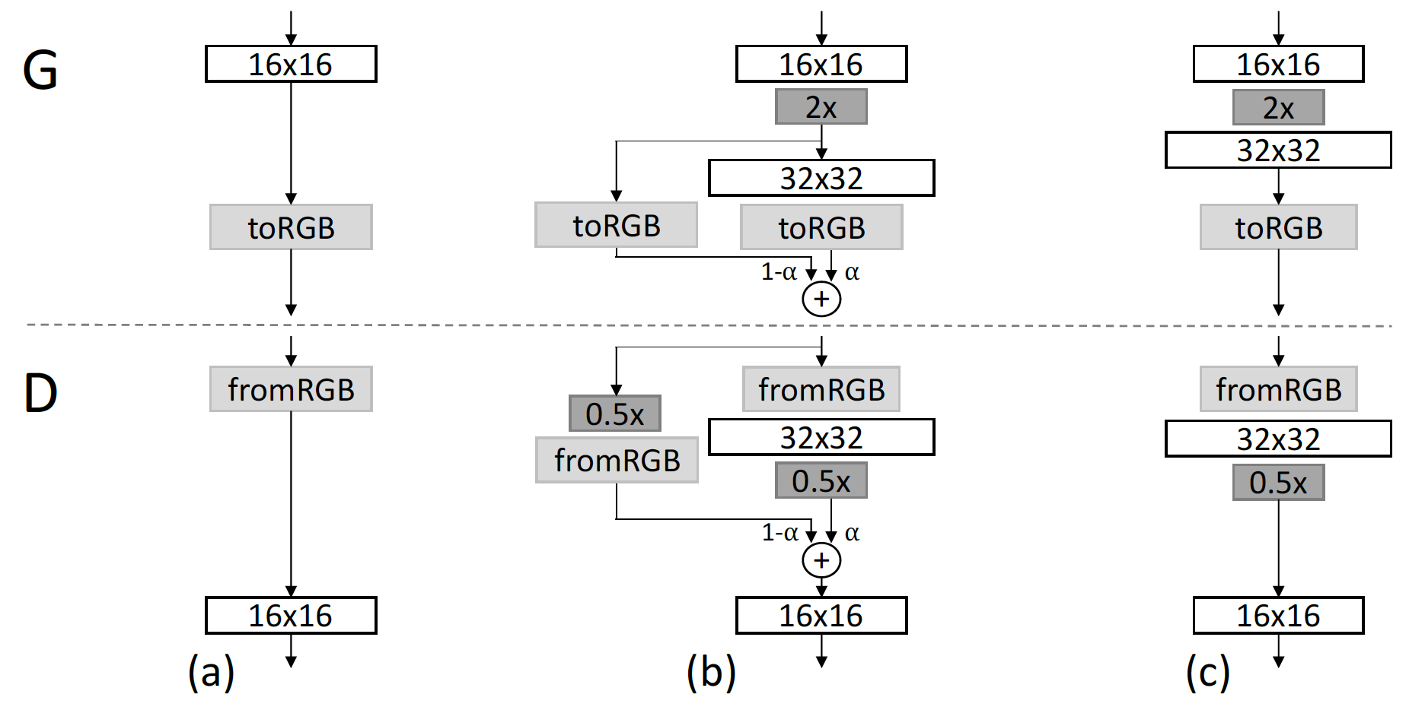
Progressive growing GANs
Increasing variation using minibatch standard deviation

Slide 6
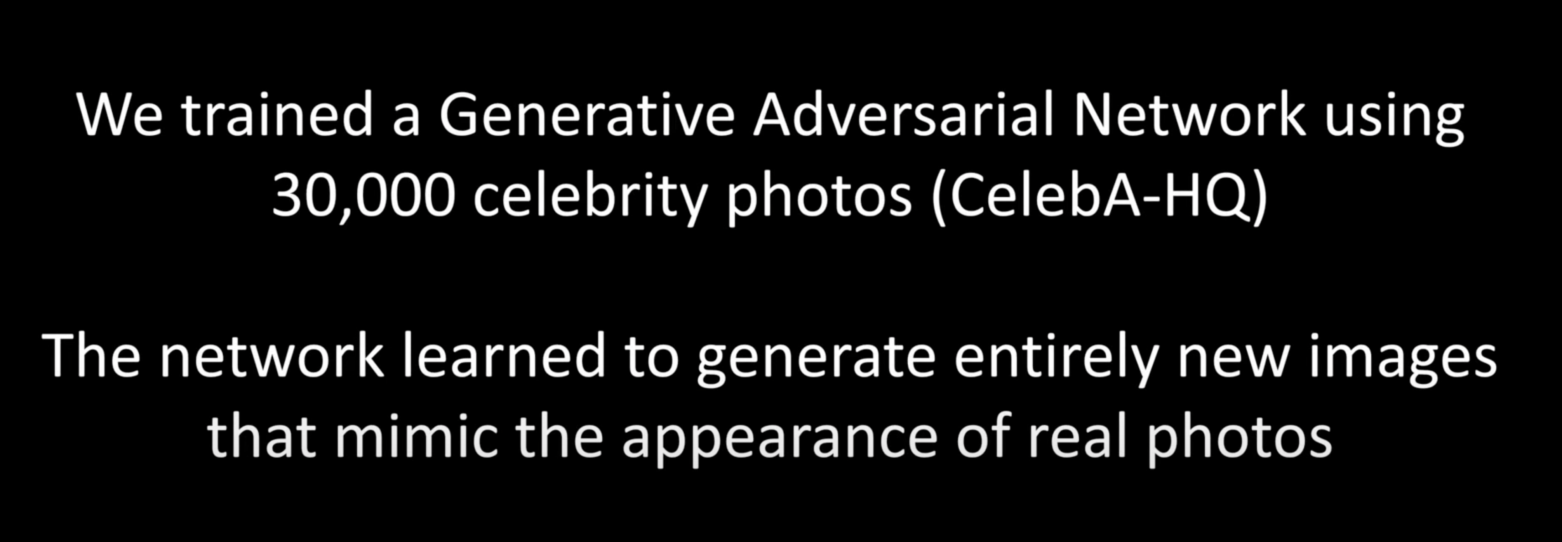
Progressive growing GANs
Video: http://youtube.com/watch?v=G06dEcZ-QTg

Slide 7
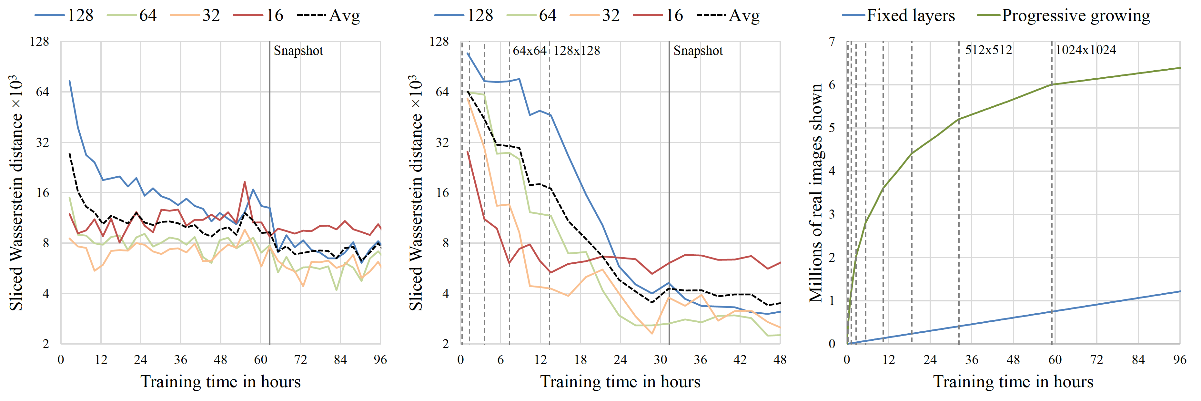
Progressive growing GANs
The timings were measured on a single-GPU setup using NVIDIA Tesla P100.

Slide 8
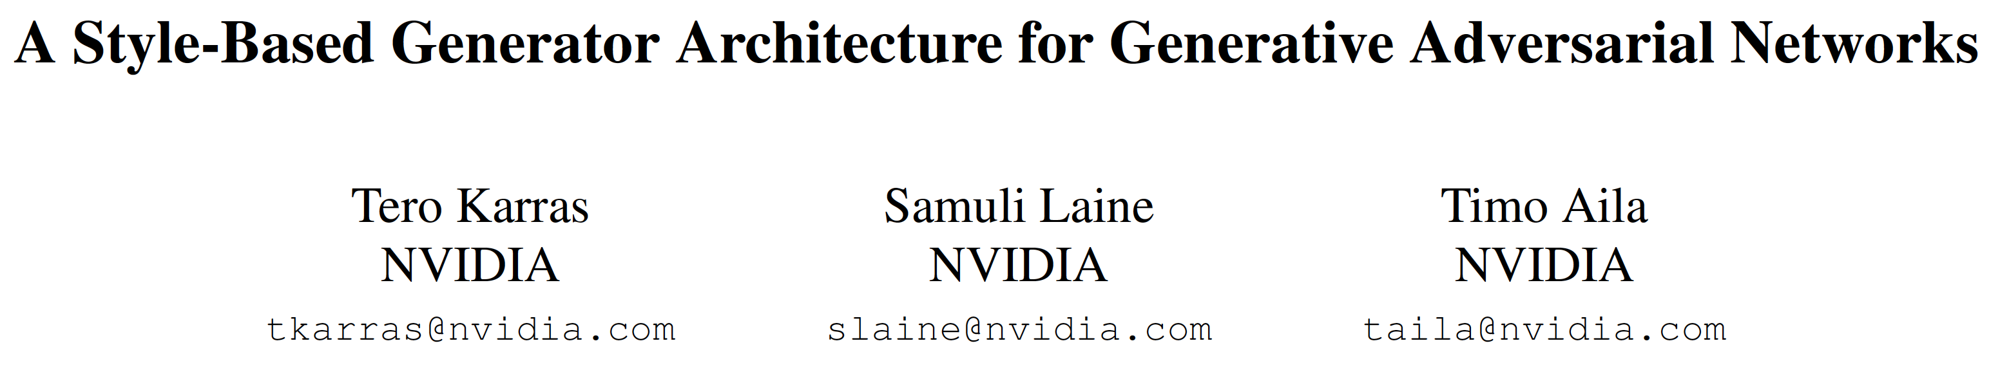
StyleGAN (2019)

Slide 9
StyleGAN
Contribution:
An alternative generator architecture for generative adversarial networks based on style transfer.
Improvements:
An automatically learned, unsupervised separation of high-level attributes (e.g., pose and identity when trained on human faces).
Stochastic variation in the generated images (e.g., freckles, hair), and it enables intuitive, scale-specific control of the synthesis.

Slide 10
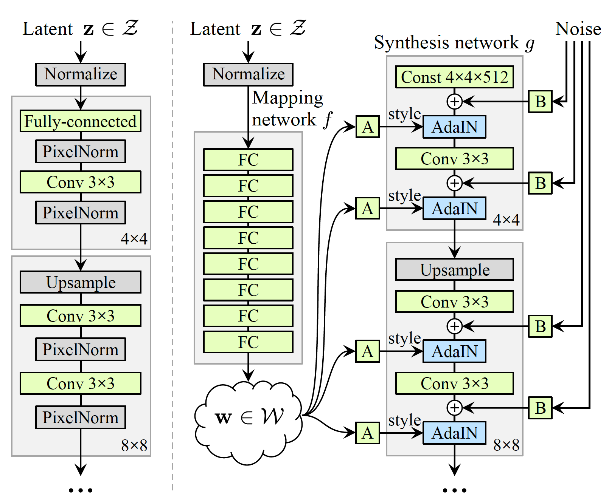
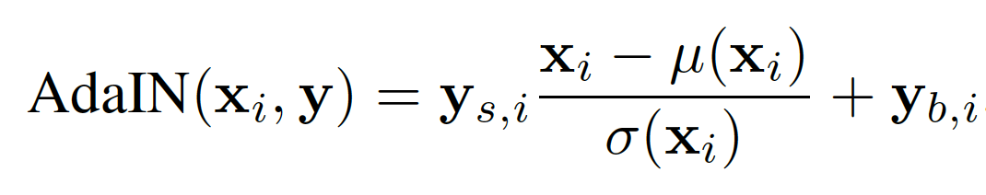
StyleGAN Generator

Slide 11
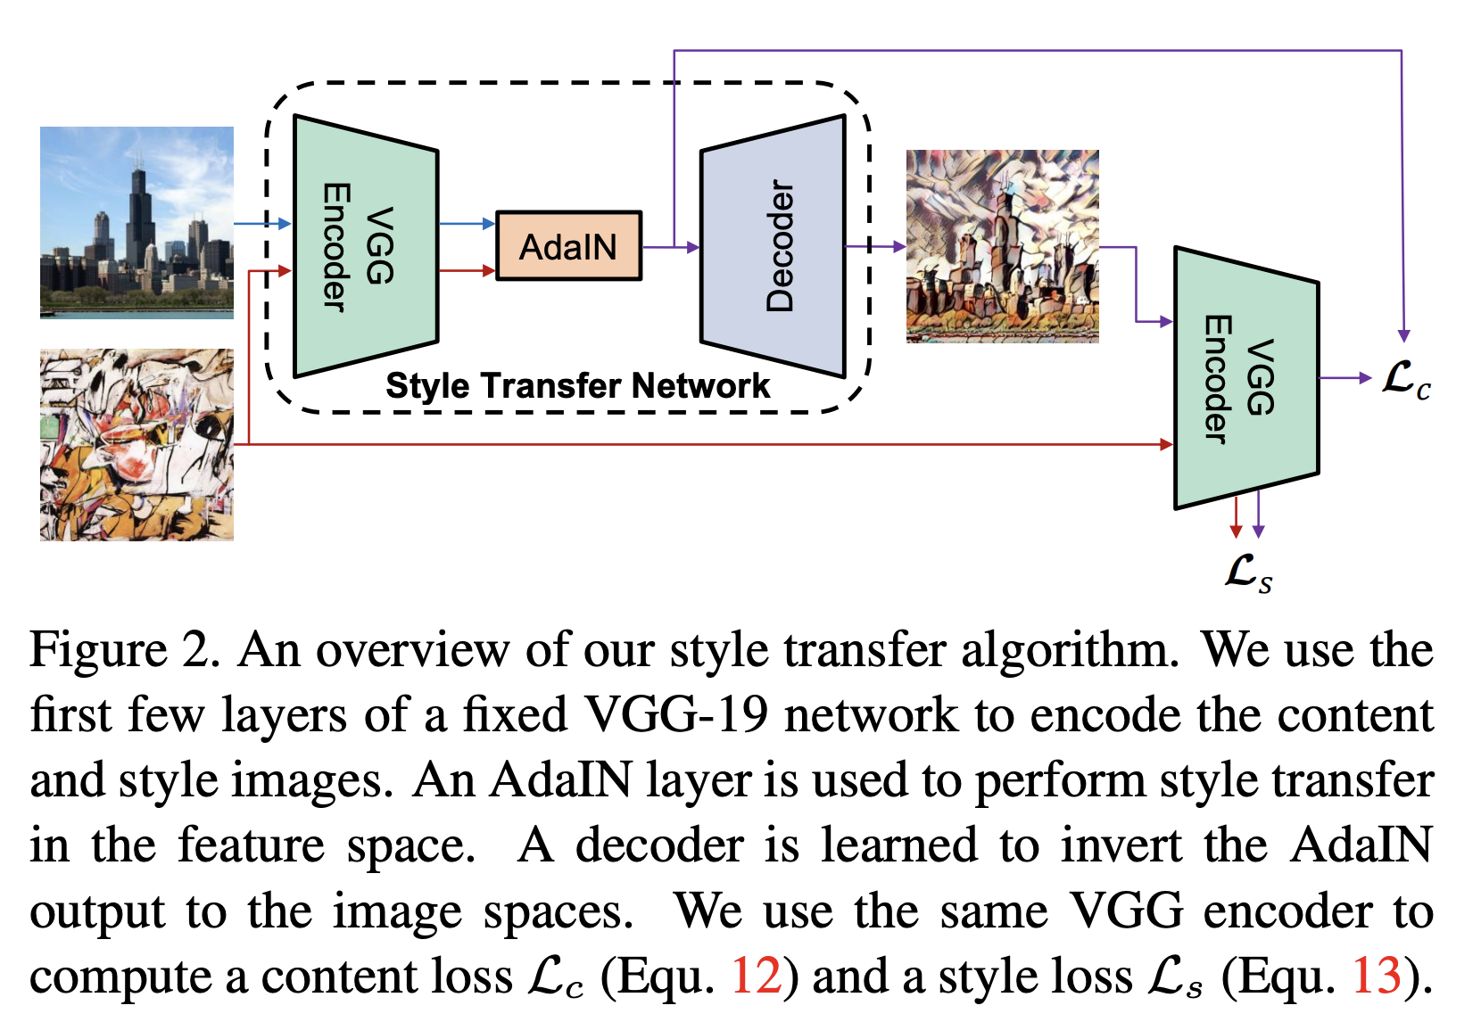
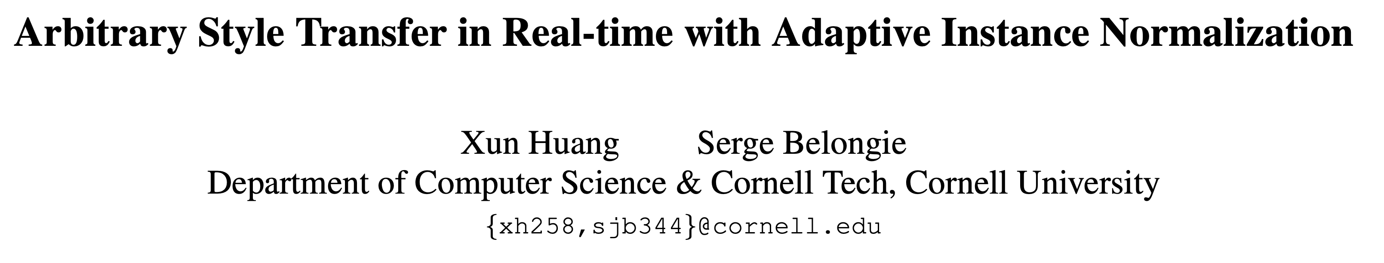
Style transfer (2017)

Slide 12
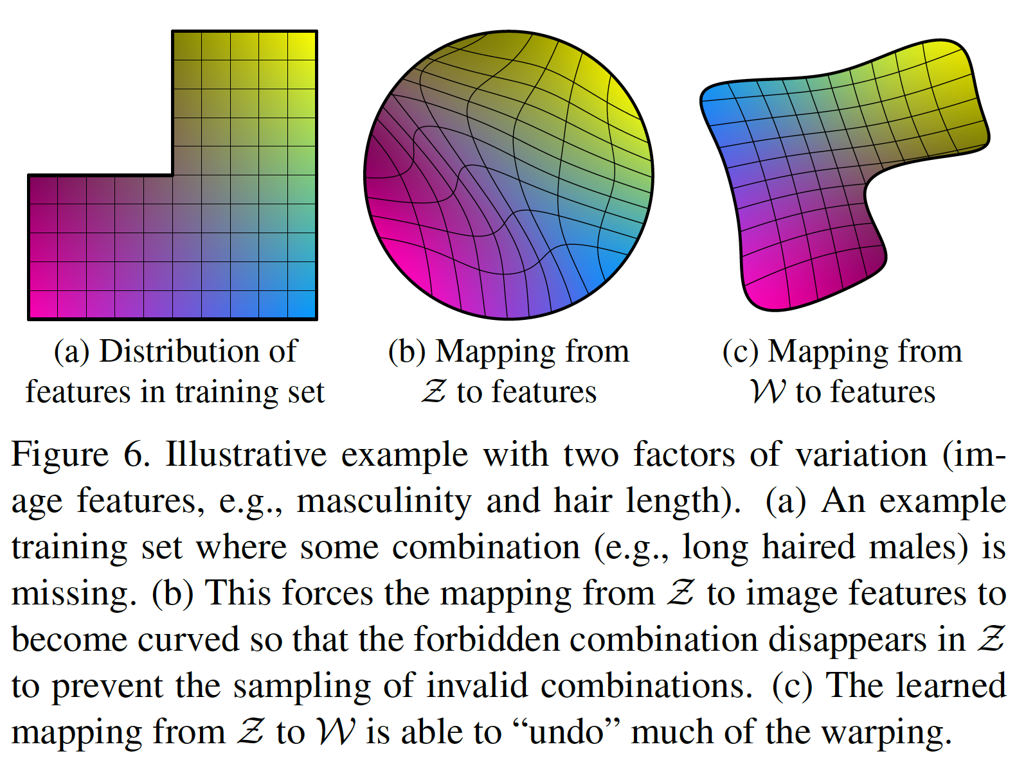
StyleGAN Mappings

Slide 13
StyleGAN – Authors’ Conclusions
"Based on both our results and parallel work by Chen et al., it is becoming clear that the traditional GAN generator architecture is in every way inferior to a style-based design. This is true in terms of established quality metrics, and we further believe that our investigations to the separation of high-level attributes and stochastic effects, as well as the linearity of the intermediate latent space will prove fruitful in improving the understanding and controllability of GAN synthesis."

Slide 14
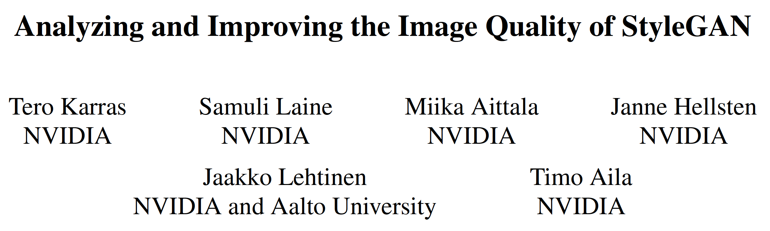
StyleGAN 2 (2020)

Slide 15
StyleGAN 2
Updates:
Redesign of the generator normalization.
Revisiting progressive growing.
Regularization of the generator to encourage good conditioning in the mapping from latent codes to images.
Benefits:
Improved image quality.
The generator becomes significantly easier to invert.

Slide 16
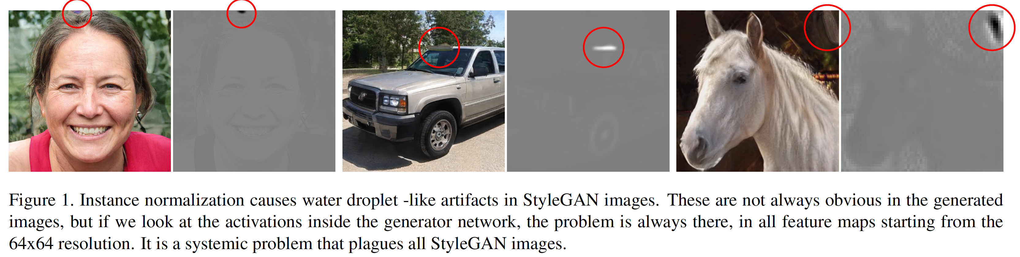
StyleGAN 2
Removing normalization artifacts

Slide 17
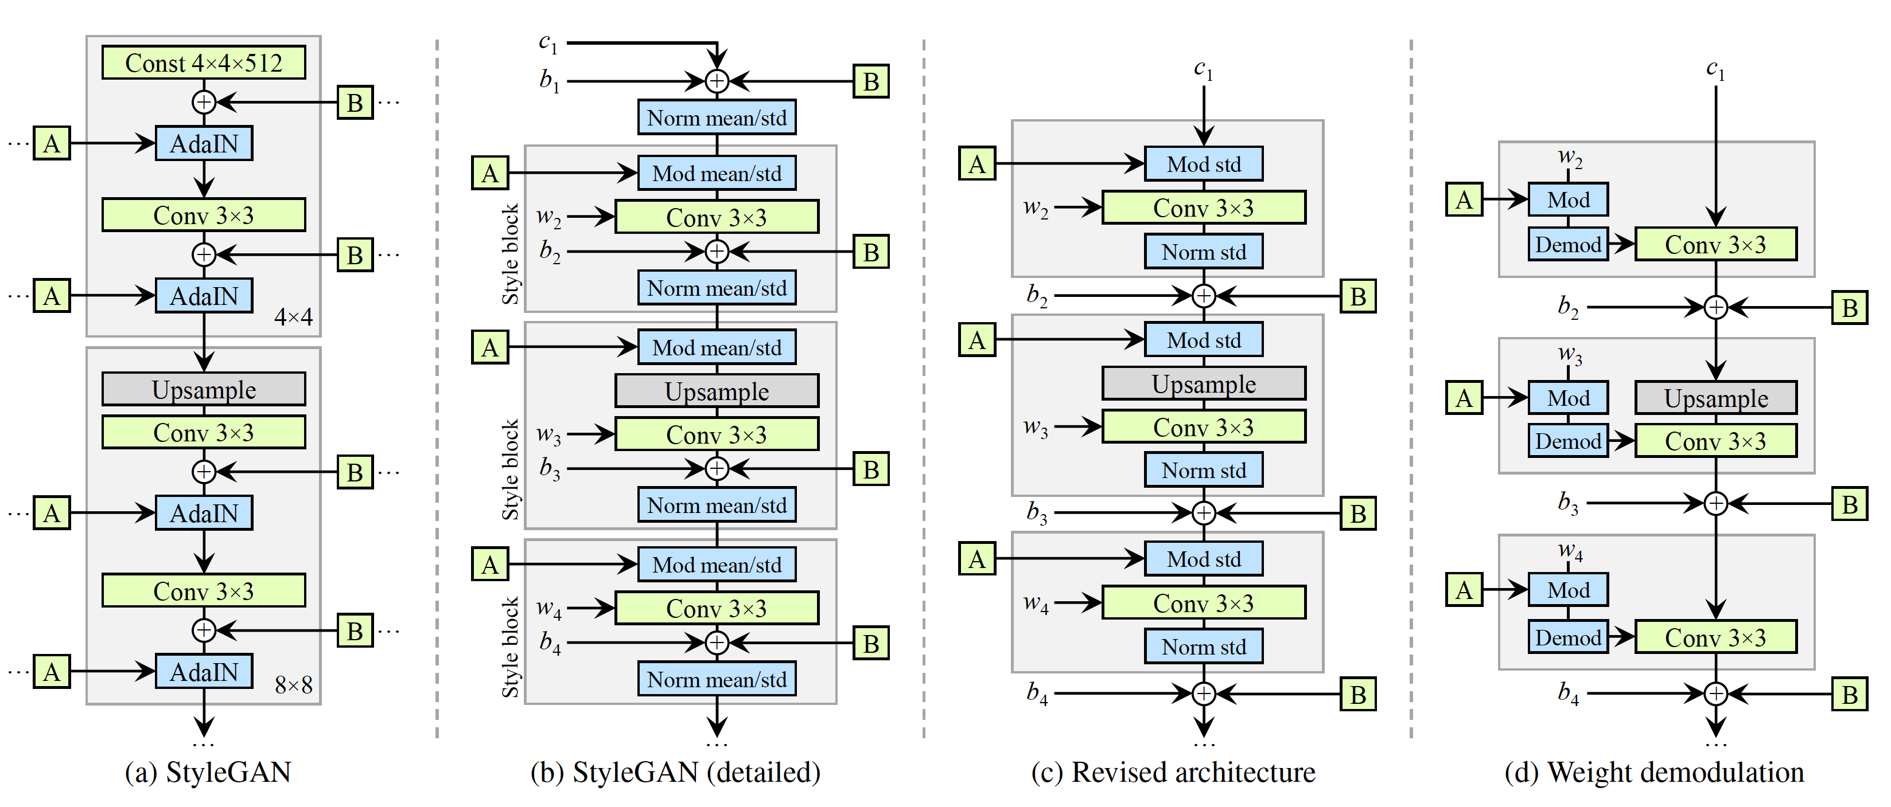
StyleGAN 2
New architecture

Slide 18
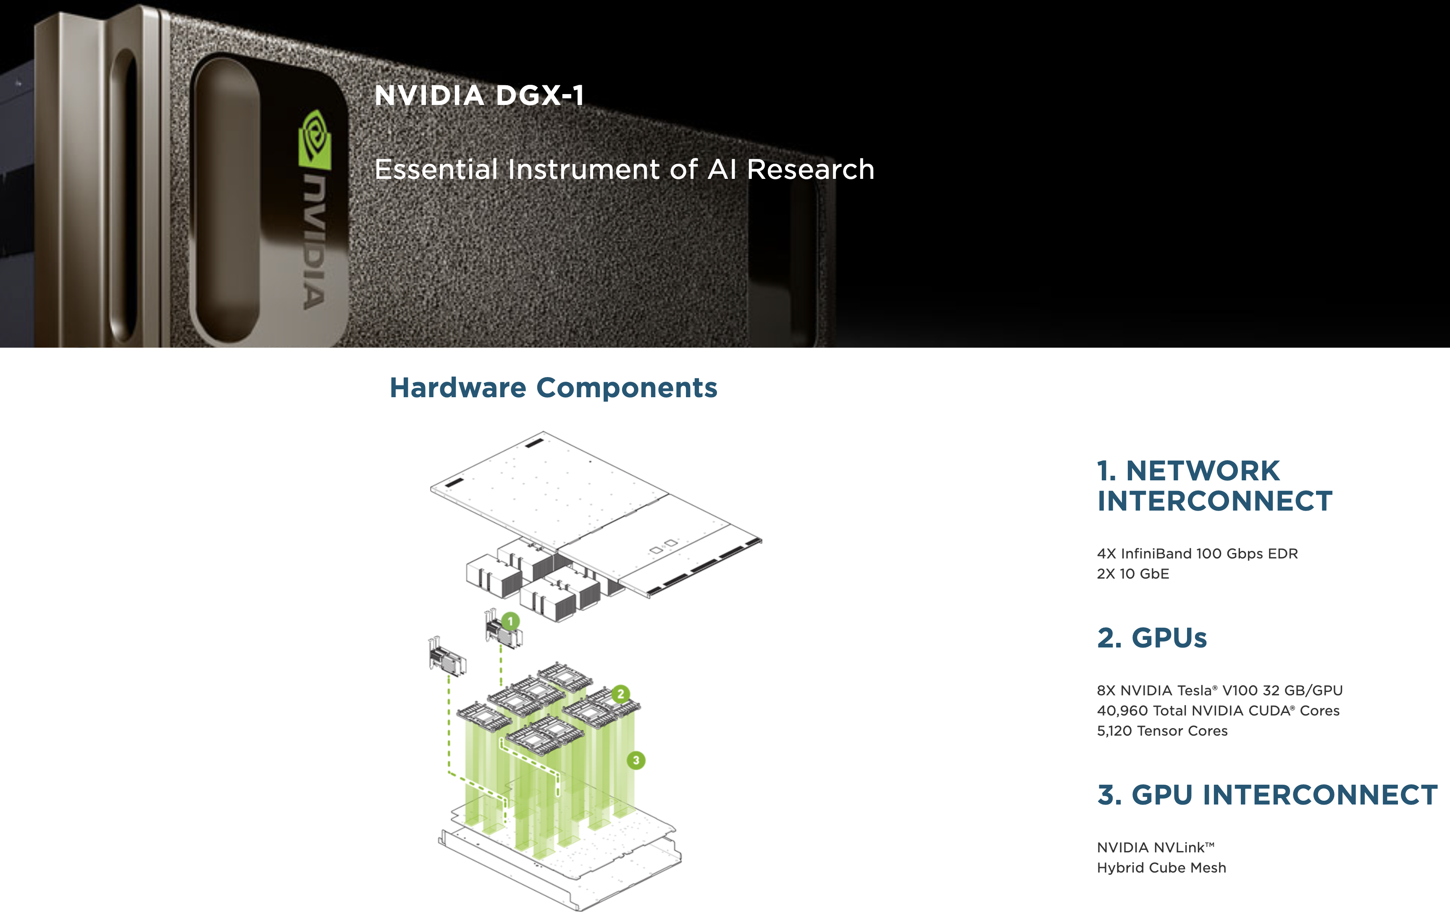
Training during the whole project
Equivalent to 51 years using one GPU!

Slide 19
Thank you!

